Slide 1
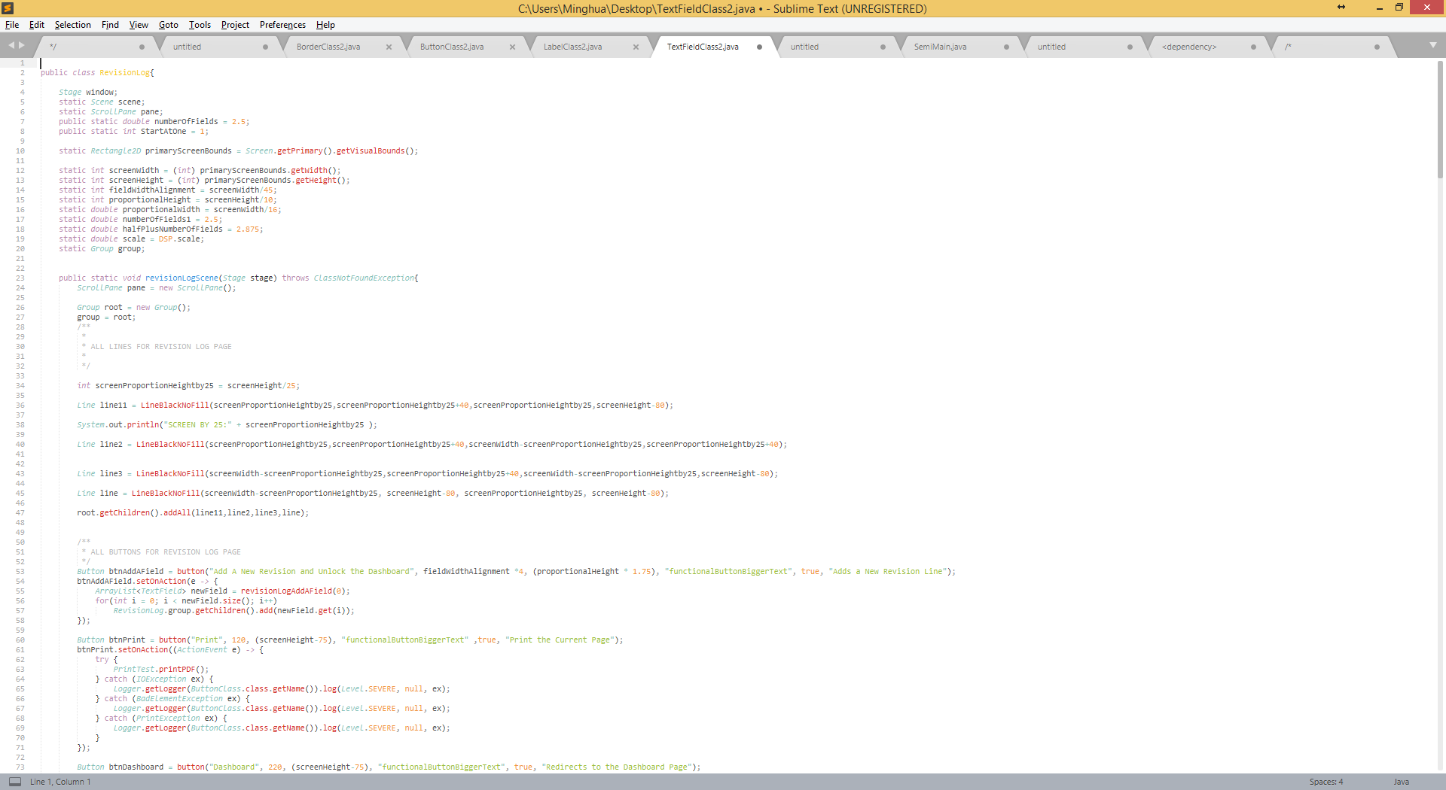
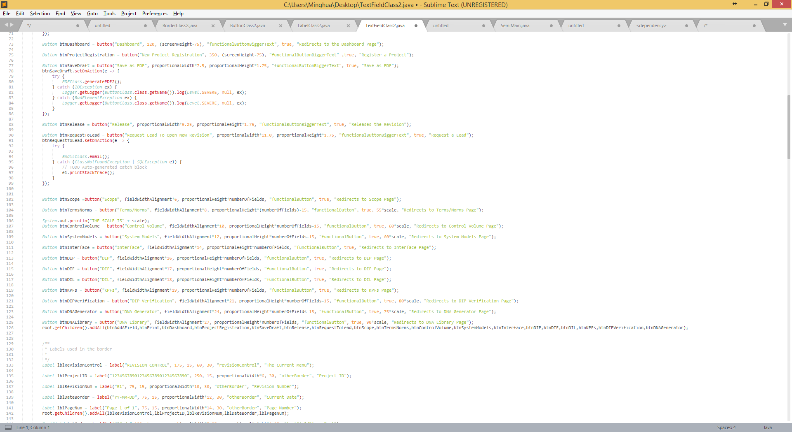
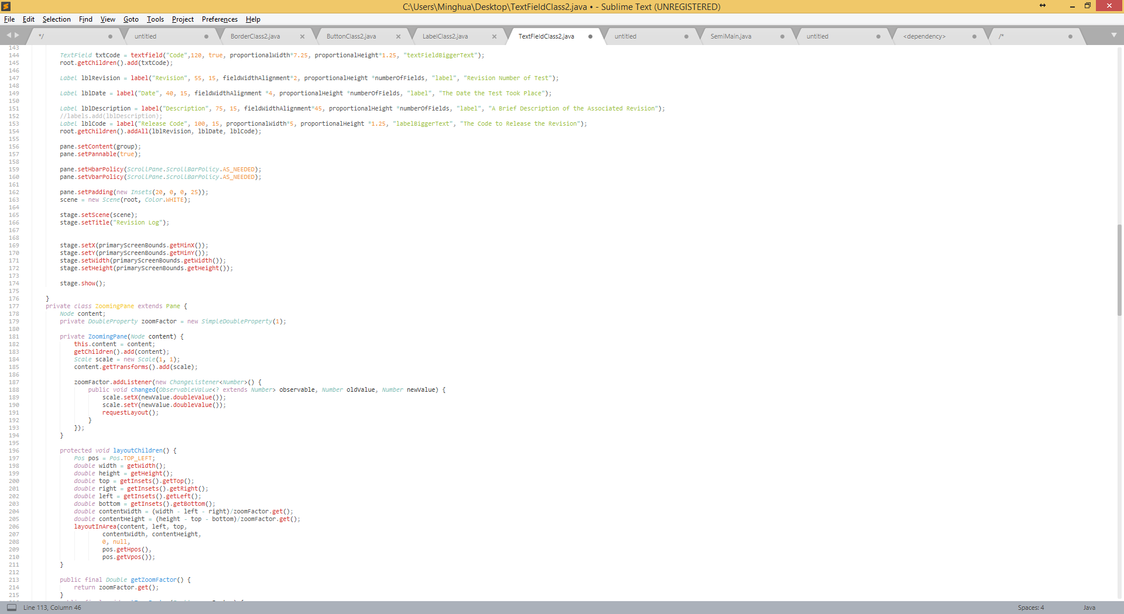
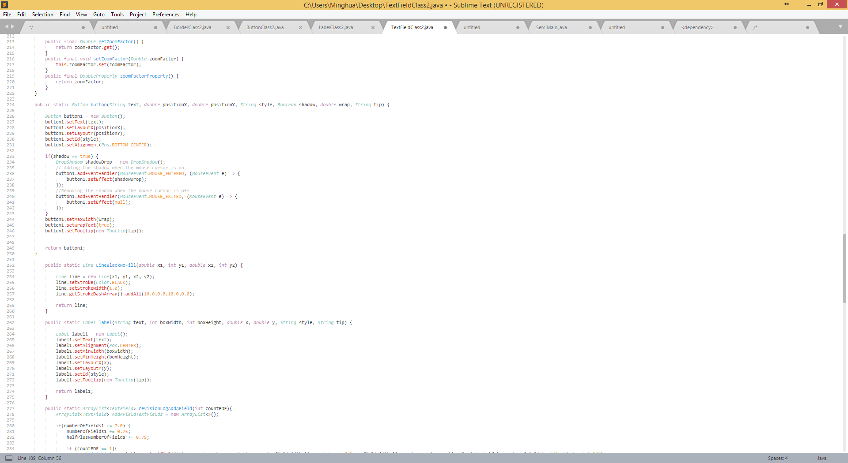
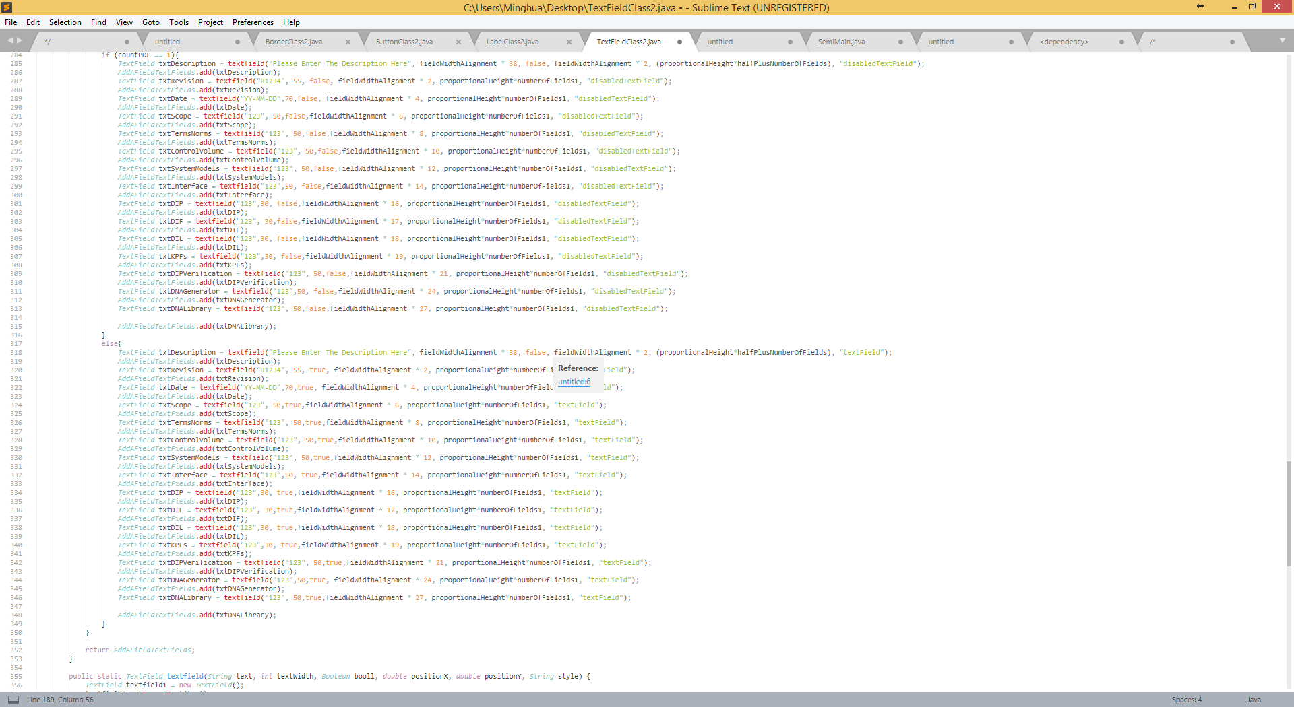
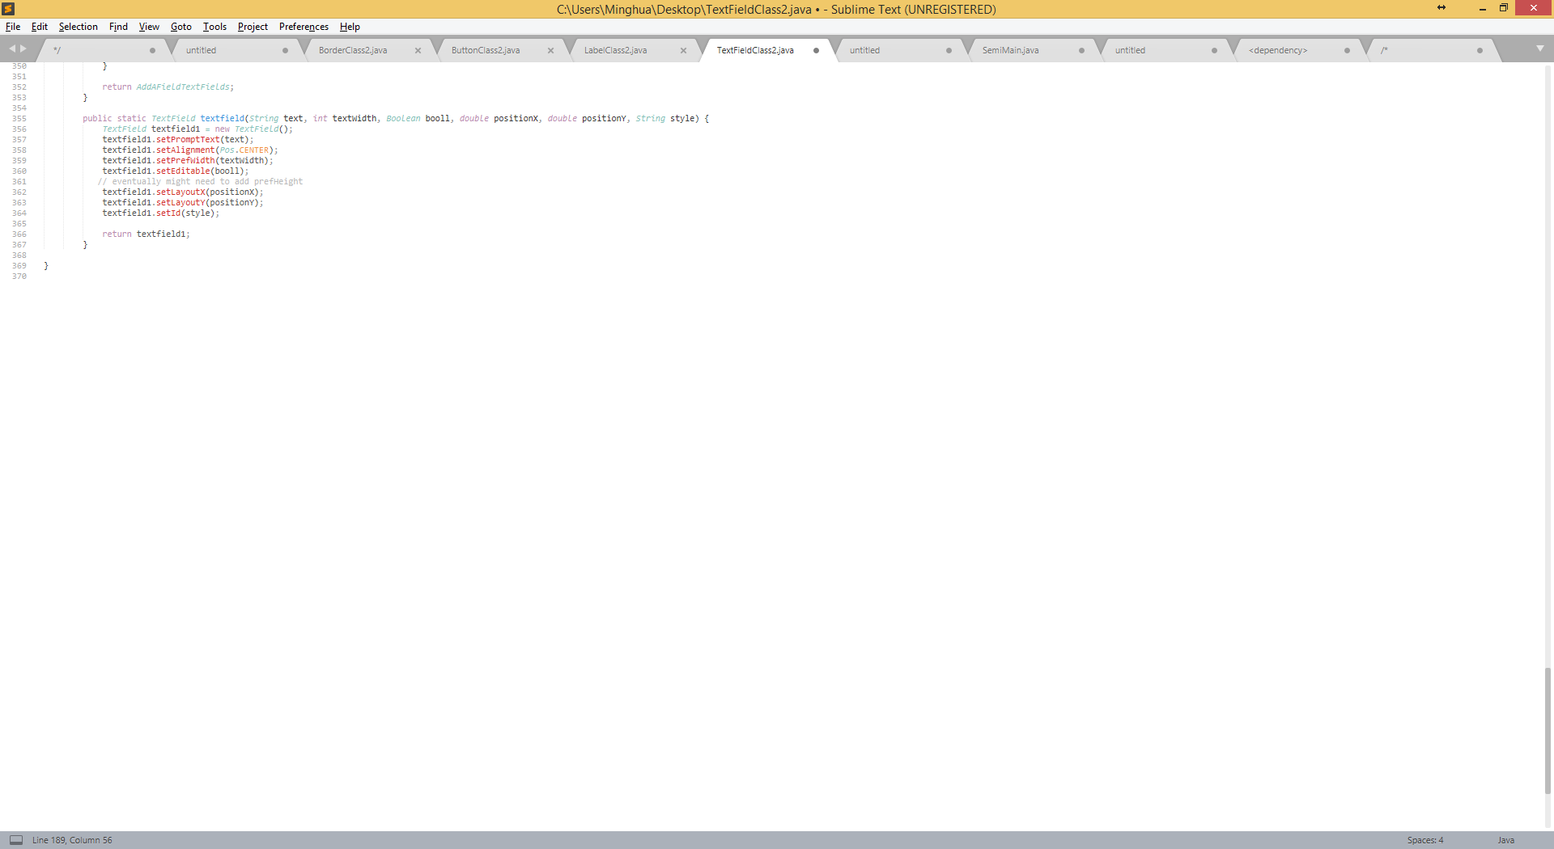
Independent
RevisionLog Class
Pros:
All-in-one file
Security
Easy to transfer to others because 1 file instead of 4-10…
Cons:
Messy due to in one file
Difficult to find what you need
Complexity increases due to overlapping of methods throughout classes
Must maintain strict organization
Lines of code: 356
Outside Interaction:
Only interacts with a DSP Class which runs this page and set’s the CSS
Medium size code explanation:
Inside the class are global variables defined that are used through out the methods.
revisionLogScene() is the primary method that calls the other methods and sets Objects to the scene. Within revisionLogScene(), it creates a layout which is where it creates all of the necessary nodes (buttons, labels, text fields, etc.) on the screen and displays it. All button functionality is also given within the primary method. Below this method is an accumulation of methods that aid in declaring these objects. There is a button() method, label() method, textfield() method, and LineBlackNoFill() method (creates a line). All of these methods, excluding the textfield() and LineBlackNoFill() methods, have overloading variants to increase flexibility in creating nodes.

Slide 2
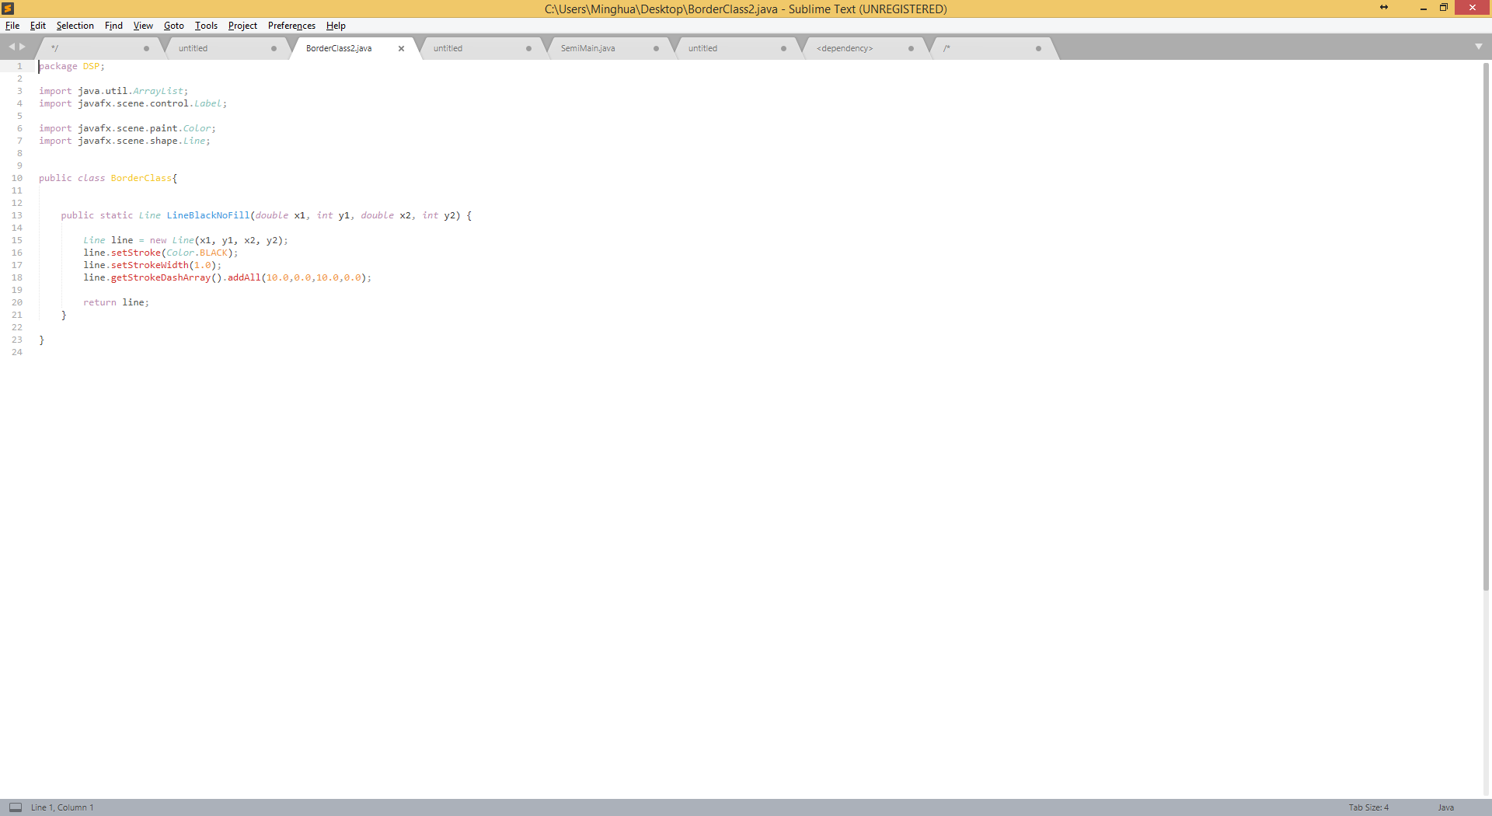
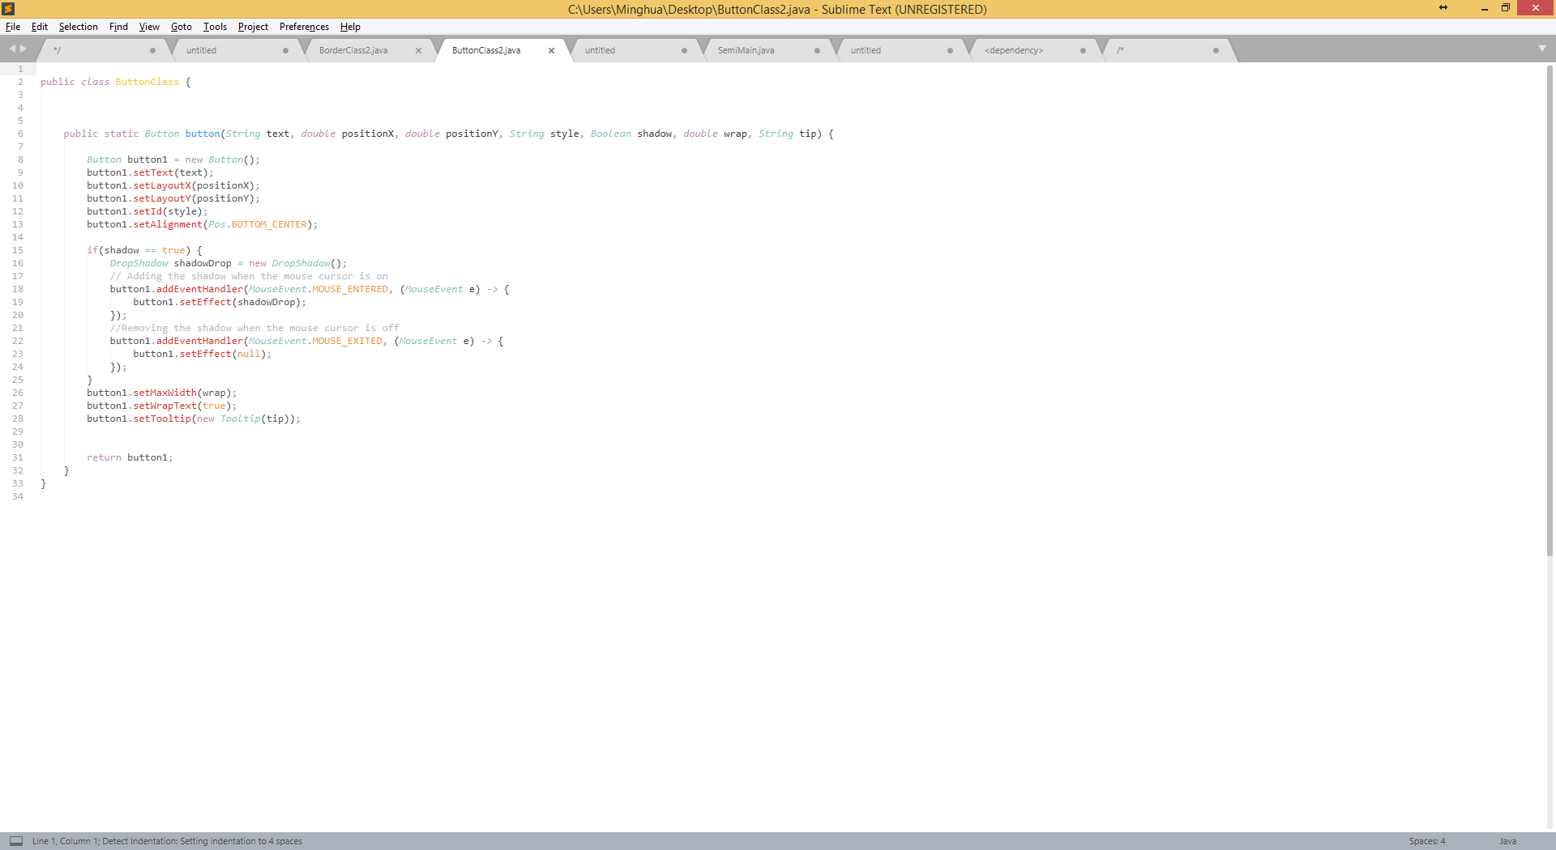
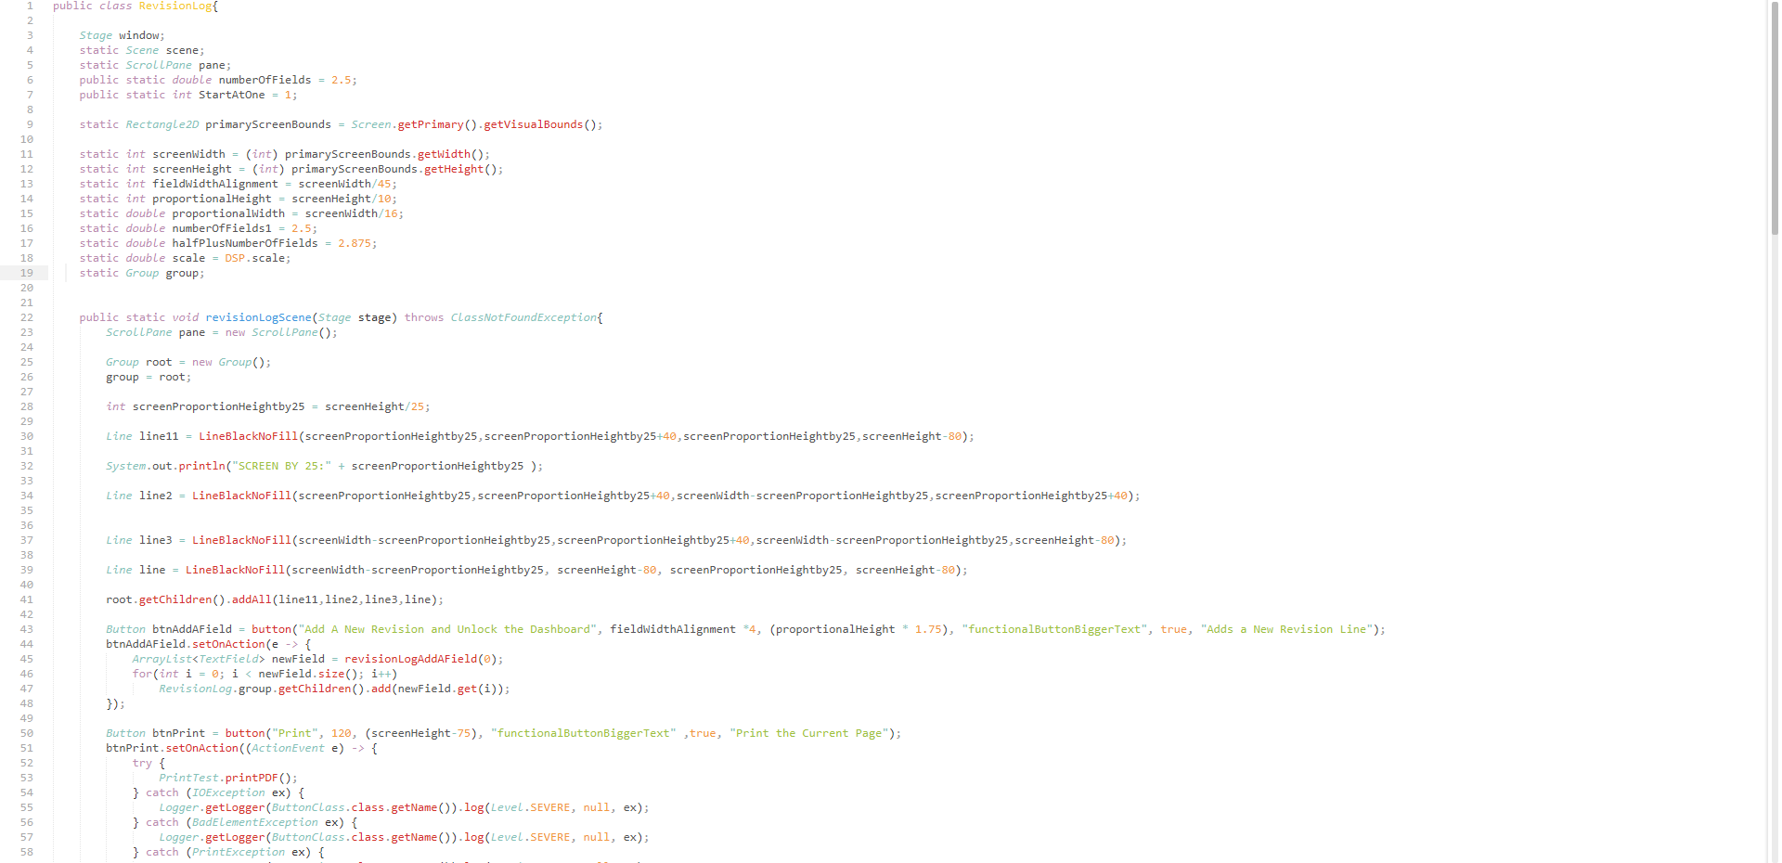
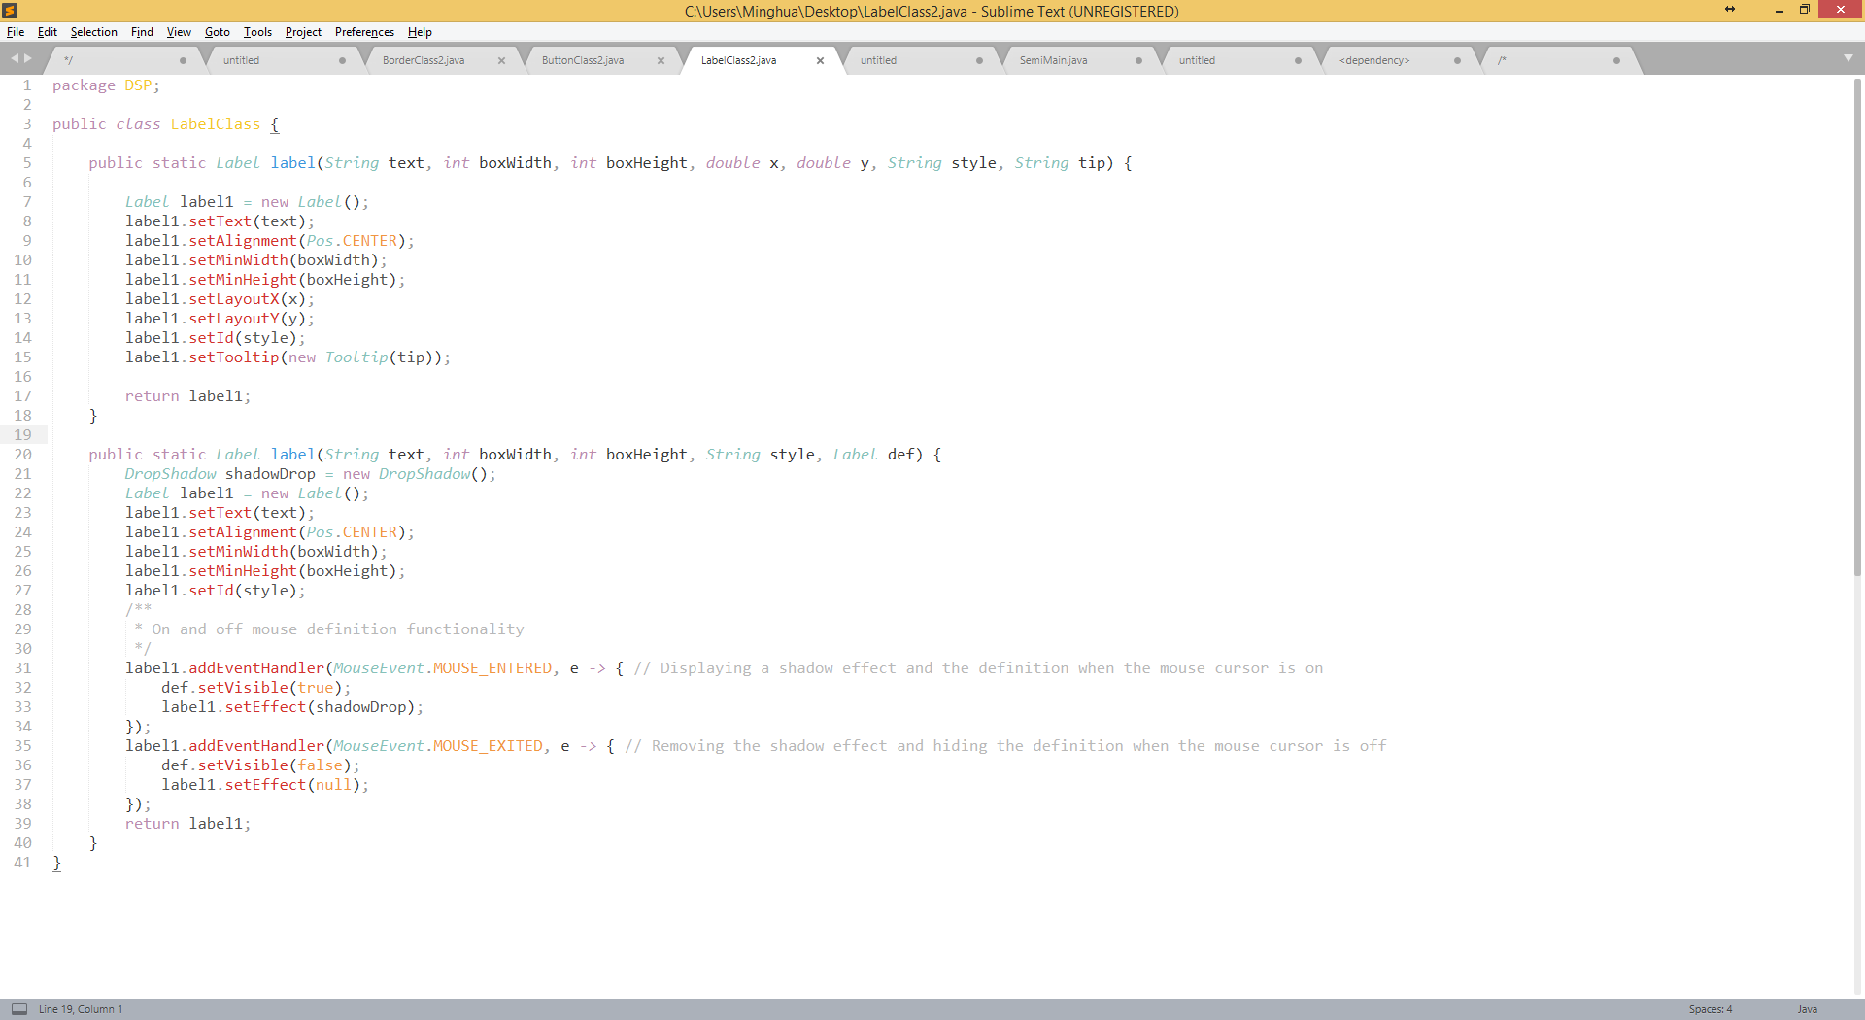
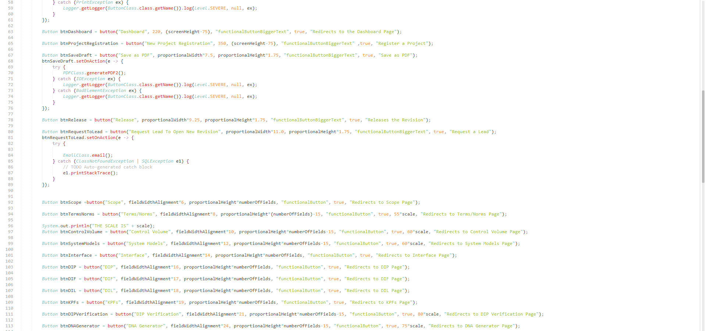
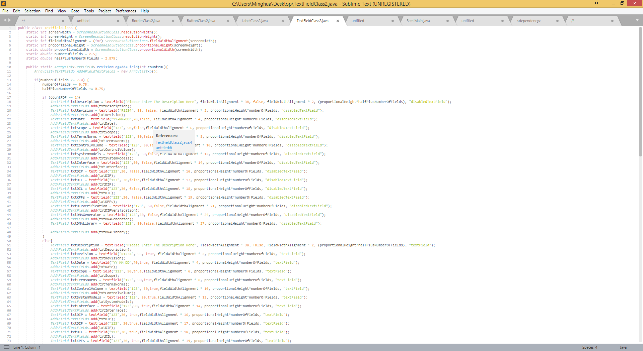
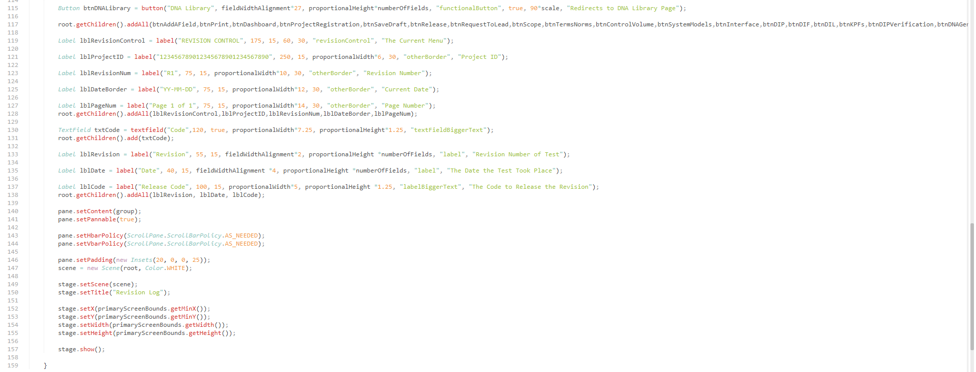
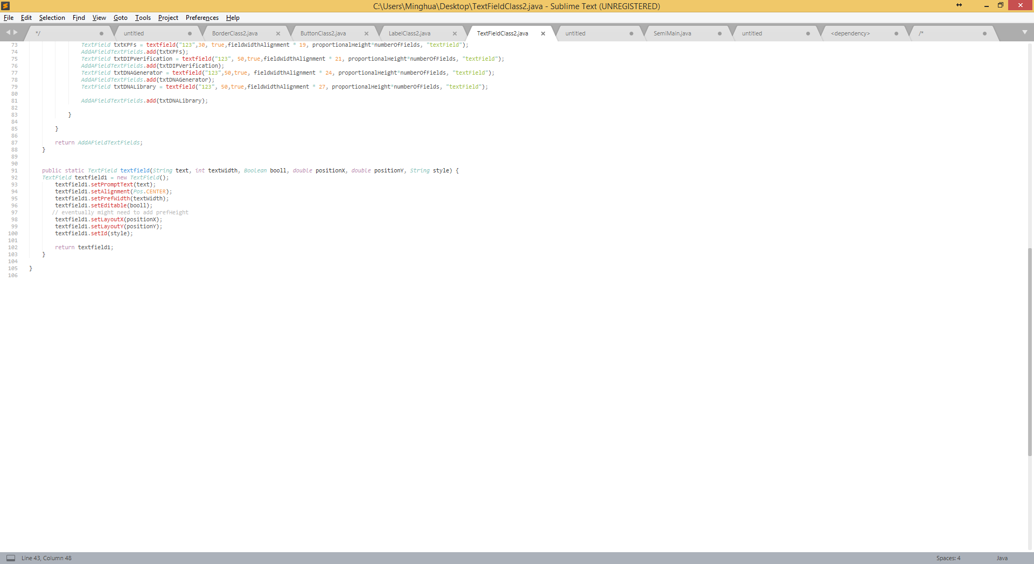
Semi
Pros:
Efficient
Easy to read/understand
Other Classes use common classes to reduce complexity
Cons:
Multiple classes
Difficult to transfer classes
BorderClass
RevisionLog
ButtonClass
Lines of code: Total: 361
BorderClass: 23 lines
ButtonClass: 33 lines
LabelClass: 41 lines
TextfieldClass: 103 lines
RevisionLog: 161 lines
Outside Interaction:
Only interacts with a DSP Class which runs RevisionLogScene class and set’s the CSS
Medium size code explanation:
revisionLogScene() is the primary method that calls the other Classes and declares other objects to the layout. Within revisionLogScene(), it creates a layout which is where it creates all of the necessary nodes (buttons, labels, text fields, etc.) on the screen and displays it. All button functionality is also given within the primary method. Below this method is an accumulation of methods that aid in declaring these objects.
RevisionLogScene is dependent on a BorderClass, TextFieldClass, LabelClass, and Textfield Class
Button() Class (dependent on all classes utilizing it): Initializes different button overloading methods, the methods are called to different layout where they are declared and used
Label() Class (dependent on all classes utilizing it): Initializes different Label overloading methods, where the methods are declared when called.
Textfield() Class (dependent on all classes utilizing it): Initializes different textfield overloading methods that are declared when they are called from a layout.
Border Class (dependent on all classes utilizing it): Which includes LineBlackNoFill() method (creates a line). Initializes different overloading line methods that are declared when they are called from a class with the correct parameters.
All of these methods, excluding the textfield() and LineBlackNoFill() methods, have overloading variants to increase flexibility in creating nodes.
LabelClass
TextFieldClass

Slide 3
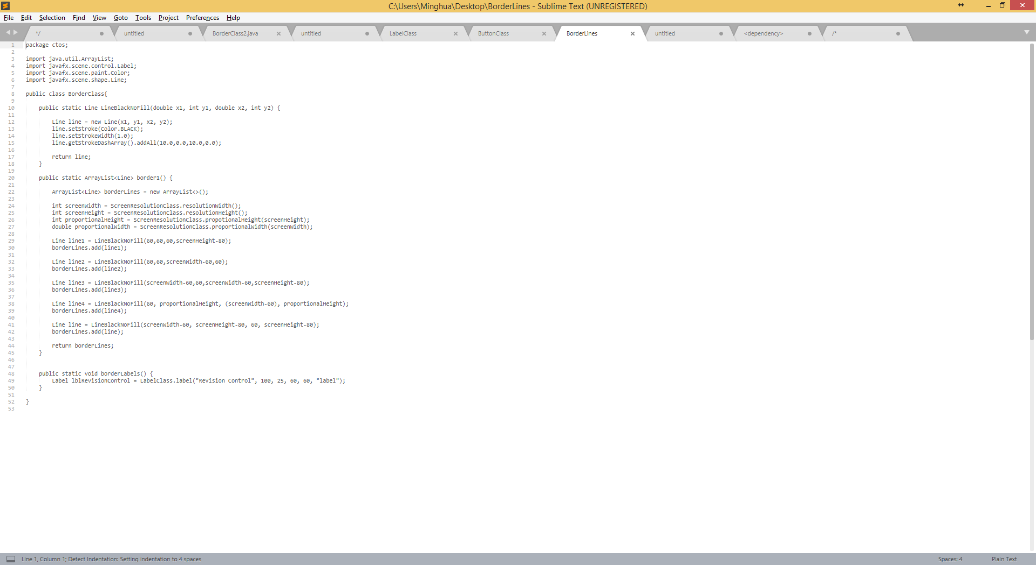
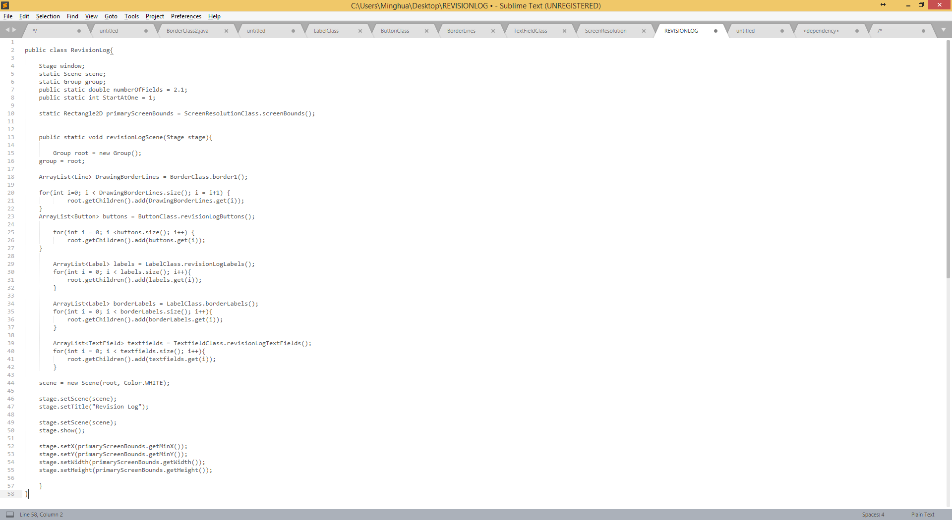
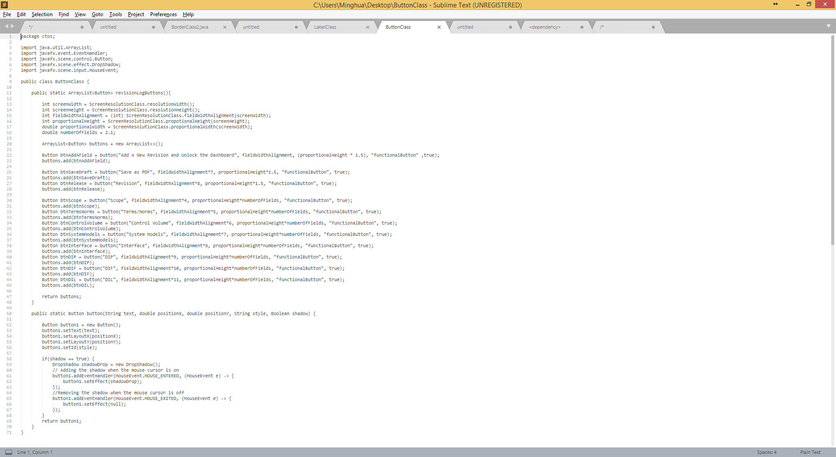
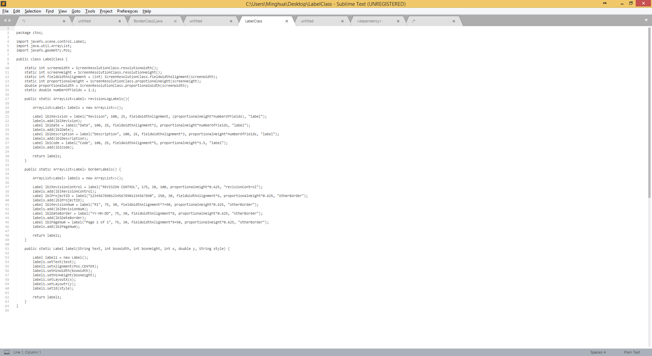
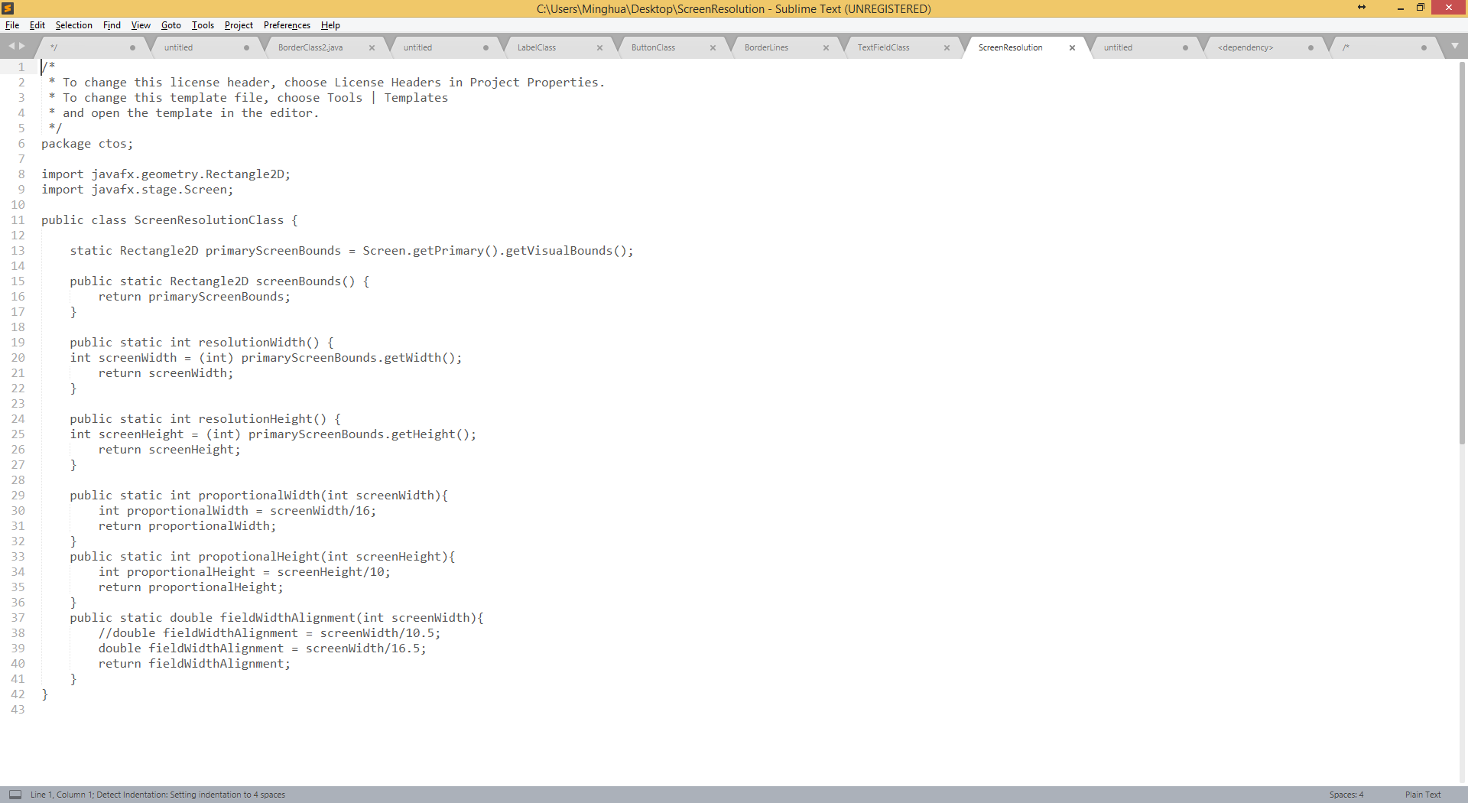
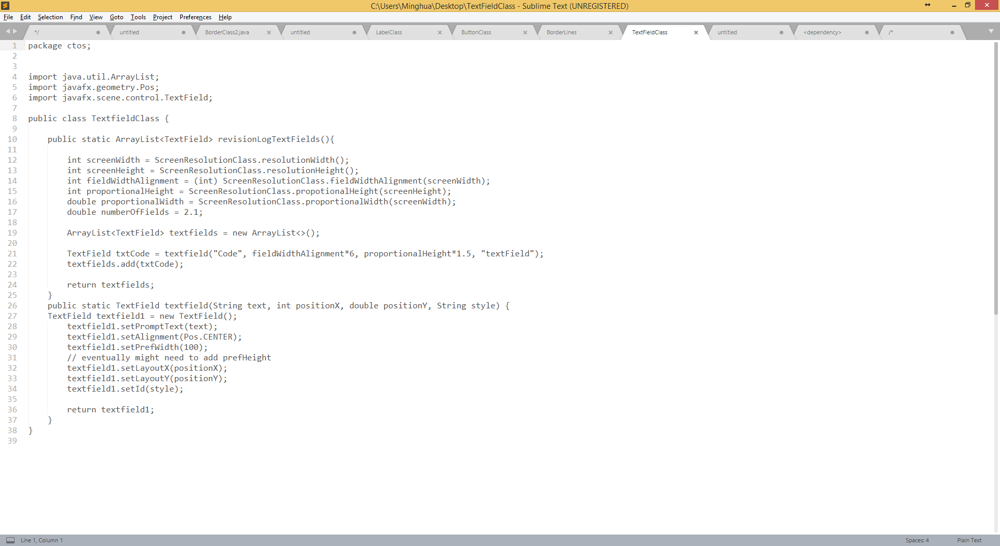
Distributed
Pros:
Modular
Somewhat efficient -> ArrayLists decrease efficiency
Cons:
Many Different Classes
Difficult to transfer to someone else
BorderClass
RevisionLog
Lines of code: Total: 347
BorderClass: 52 lines
ButtonClass: 71 lines
LabelClass: 65 lines
TextfieldClass: 38 lines
RevisionLog: 83 lines
ScreenResolution: 38
Outside Interaction:
Only interacts with a DSP Class which runs RevisionLogScene class and set’s the CSS
Medium size code explanation:
revisionLogScene() is the primary method that calls the other Classes and declares other objects to the layout.
Within revisionLogScene(), it creates a layout and iterates through an ArrayList of each subject simultaneously adding the object to the Layout. All button functionality is also given within the primary method. Below this method is an accumulation of methods that aid in declaring these objects.
RevisionLogScene is dependent on a BorderClass, TextFieldClass, LabelClass, Textfield Class and ScreenResolution class.
Button() Class (dependent on ScreenResolution Class): Initializes different button overloading methods
Includes a RevisionLogButtons methods which adds all buttons in an arrayList
Label() Class (dependent on ScreenResolution Class)): Initializes different Label overloading methods, where the methods are declared when called.
Includes a RevisionLogLabels methods which adds all labels in an arrayList
Textfield() Class (dependent on ScreenResolution Class): : Initializes different textfield overloading methods
Includes a RevisionLogTextfields methods which adds all textfields in an arrayList
Border Class (dependent on ScreenResolution Class): Which includes LineBlackNoFill() method (creates a line). Initializes different overloading line methods.
All of these methods, excluding the textfield() and LineBlackNoFill() methods, have overloading variants to increase flexibility in creating nodes.
ScreenResolution Class: Contains all the dimensions of the screen as well as common dimension and ratios used within the project.
ButtonClass
Label Class
ScreenResolution Class
TextField Class

Slide 4
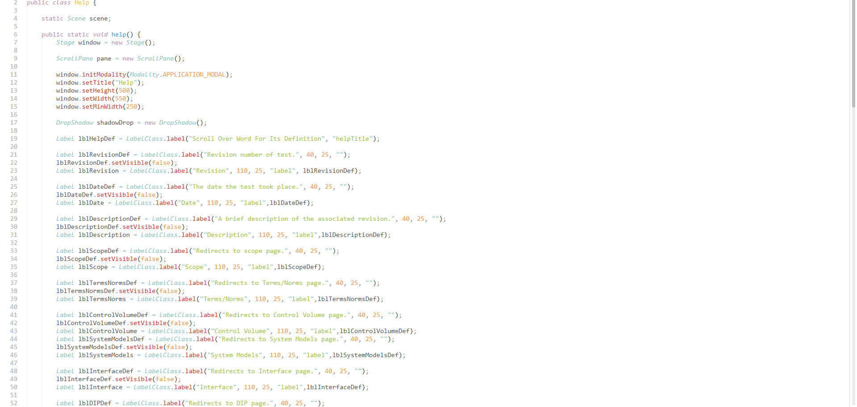
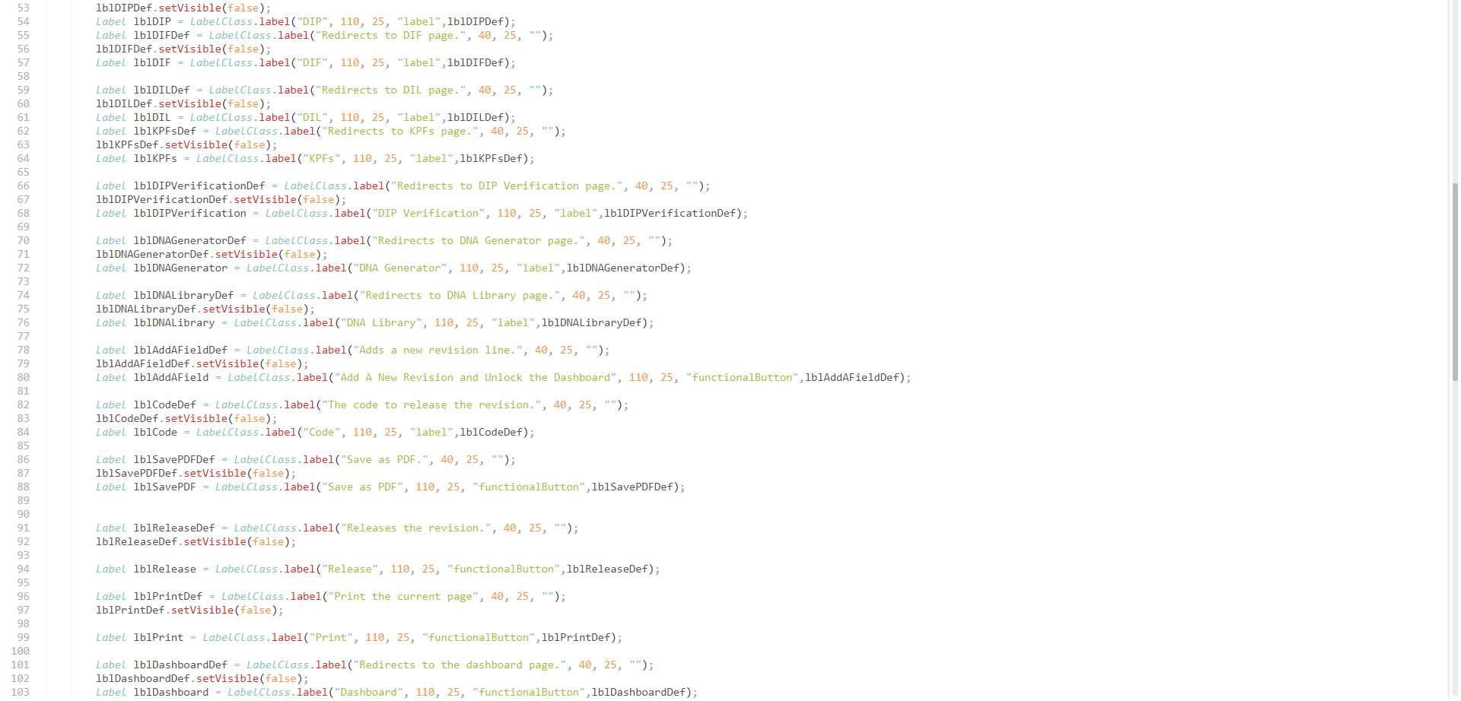
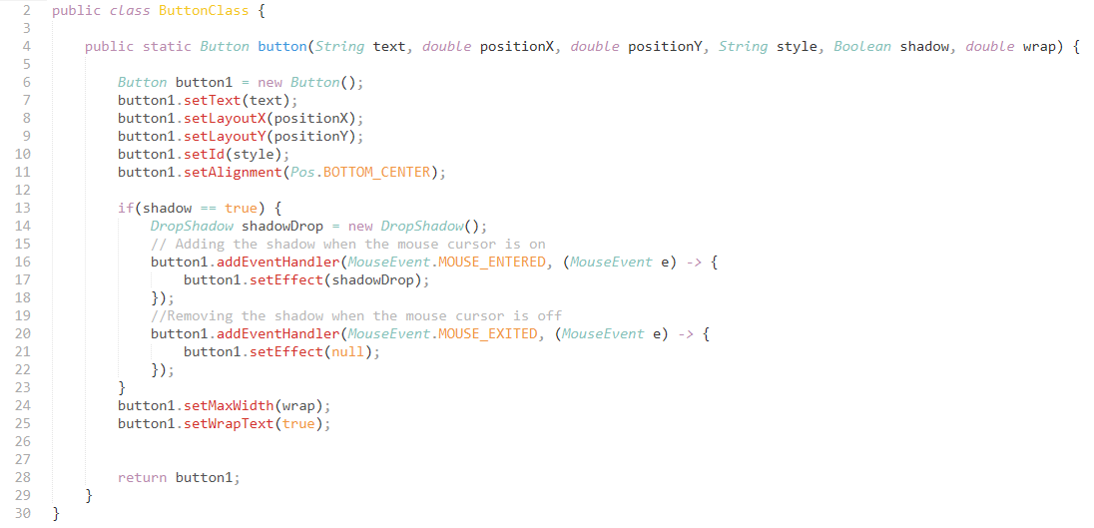
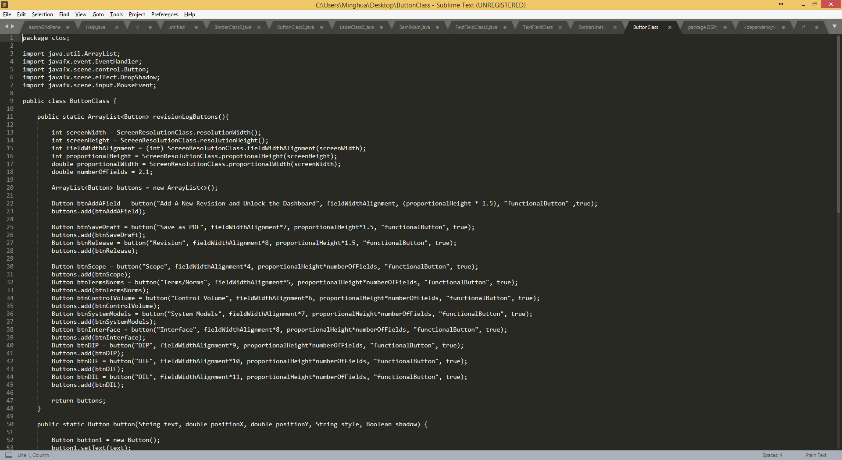
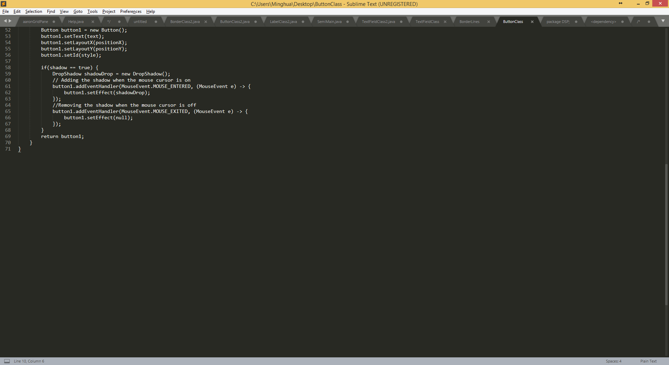
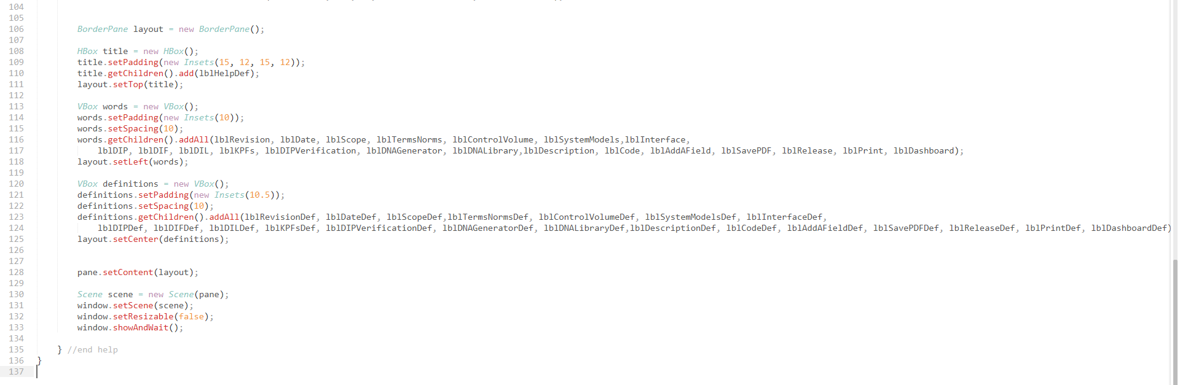
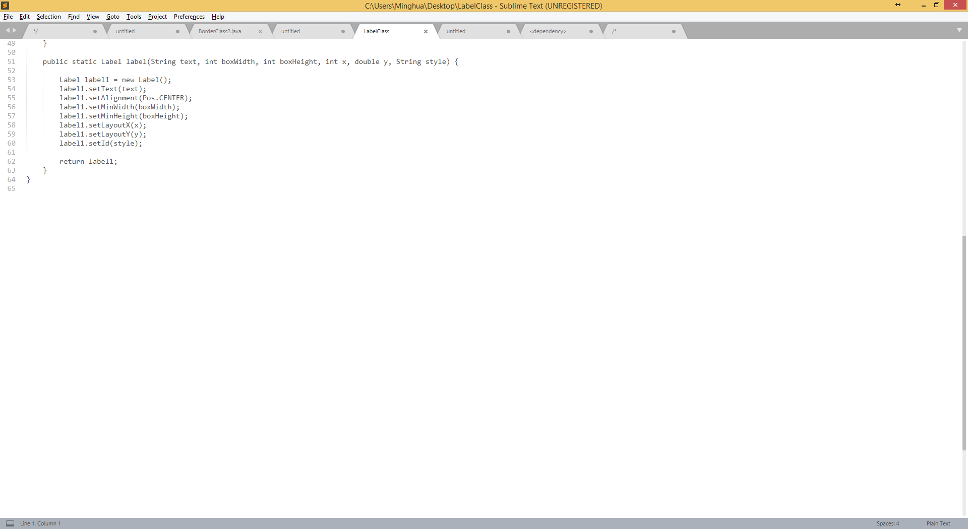
Help
Lines of code: Total: 163 (does not include irrelevant Button and label revision log methods)
Outside Interaction:
Is called with button functionality
Medium size code explanation:
Once the method is called, a new smaller pop-up window appears with every option on the current page, and will tell the user what it does if the option is hovered over.
The labels and buttons are initialized through out the ButtonClass and LabelClass.
They are then declared when they are called through out the Help Class and added to the page.
ButtonClass
Label Class

Slide 5
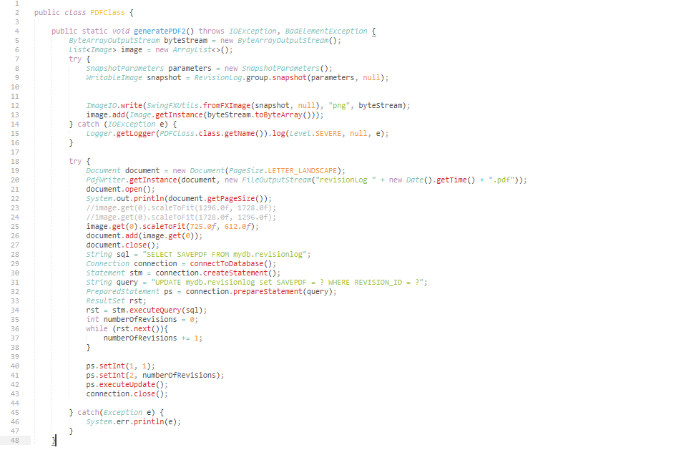
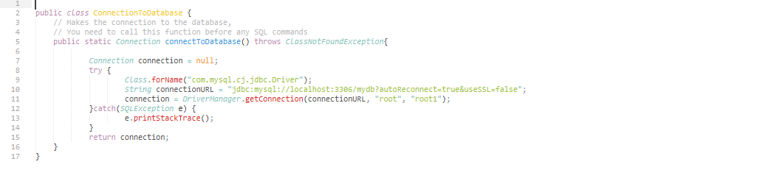
Save As PDF
Save As PDF Class
Lines of code: Total: 60
Outside Interaction:
Is called with button functionality
Dependencies: ConnectionToDatabase Class
Medium size code explanation:
Once the Class is called, it takes a screenshot of the page. It then creates a document, opens the document, adds the screenshot to the document then closes the document.
Afterwards the document is made and closed, we update the PDF database table.
Connection to Database Class

Slide 6
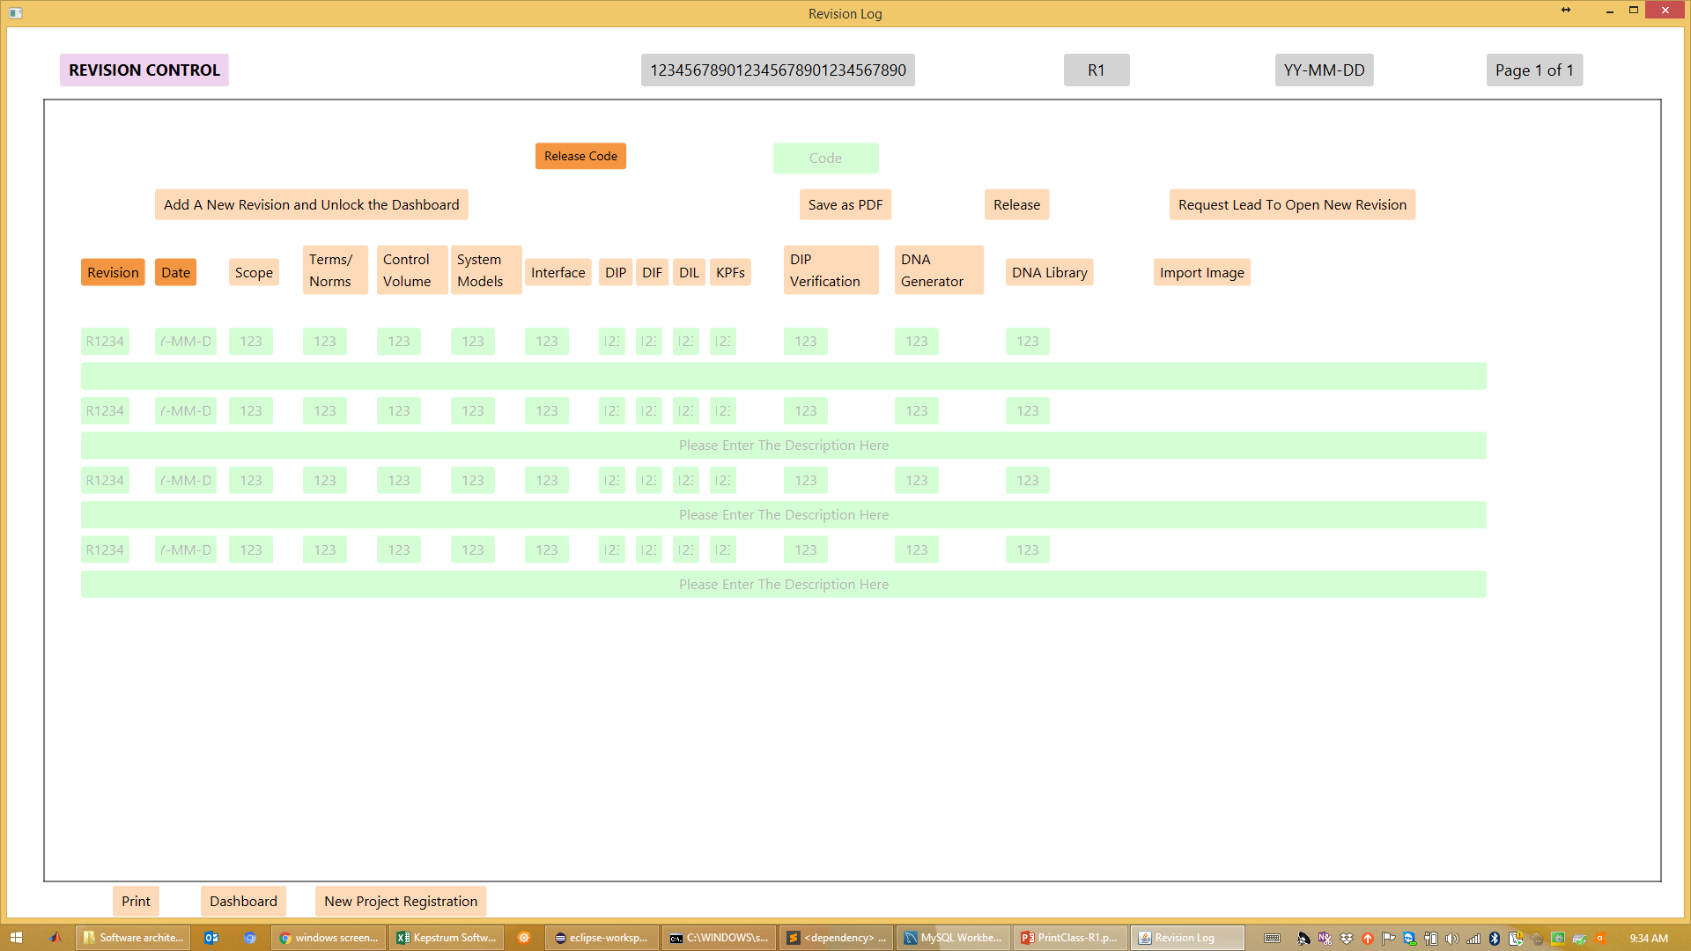
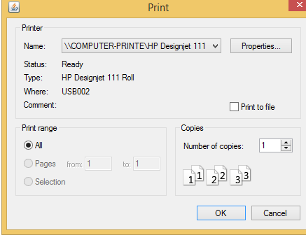
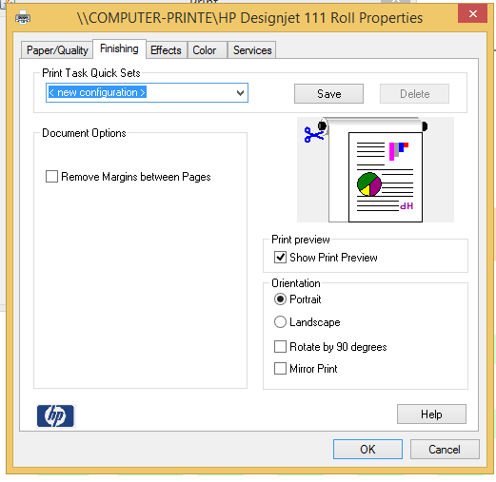
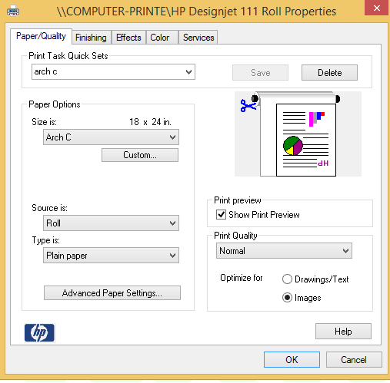
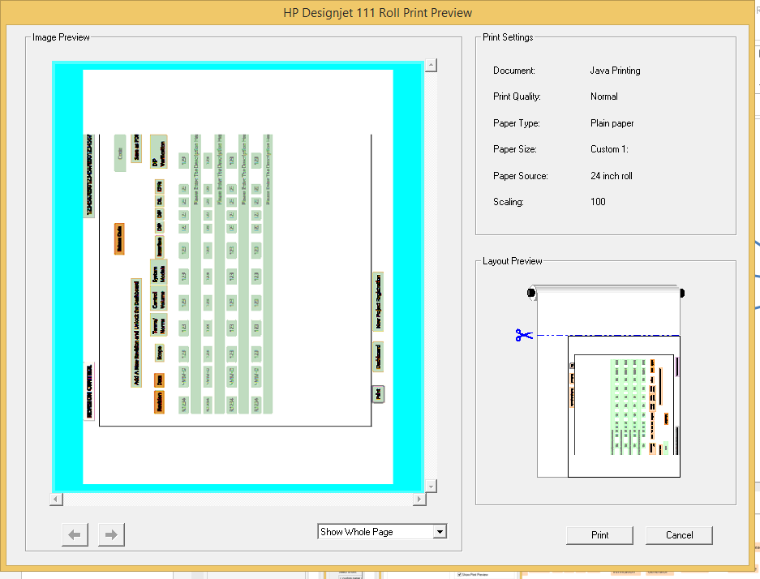
Print common components
What to print
Select Printer
Page Orientation
Page Size
Printing Results
Page Preview
Printer Needs
Type of printer specs:
Orientation
Size
Page Count

Slide 7
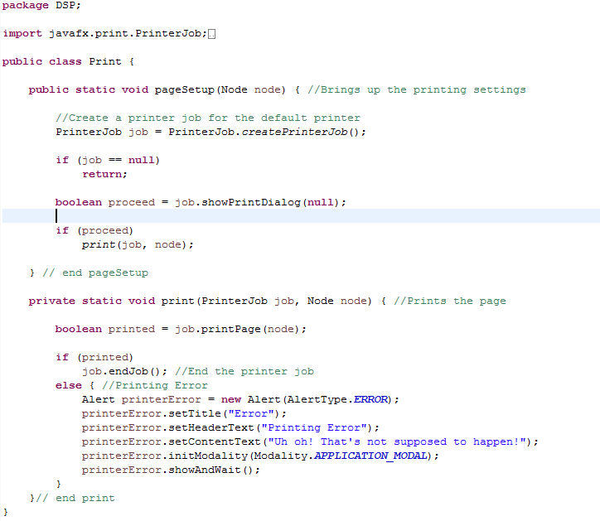
Print 1
Lines of code: Total: 37
Outside Interaction:
Is called with button functionality and sent through with a node
Dependencies: That a node is sent as a parameter
Medium size code explanation:
The pageSetup method is run with the node first. It creates a job through library print methods. If the job doesn’t exist then the method returns. If the job does exist then go to method print with the job and the node. The print method either prints the node or displays error messages.

Slide 8
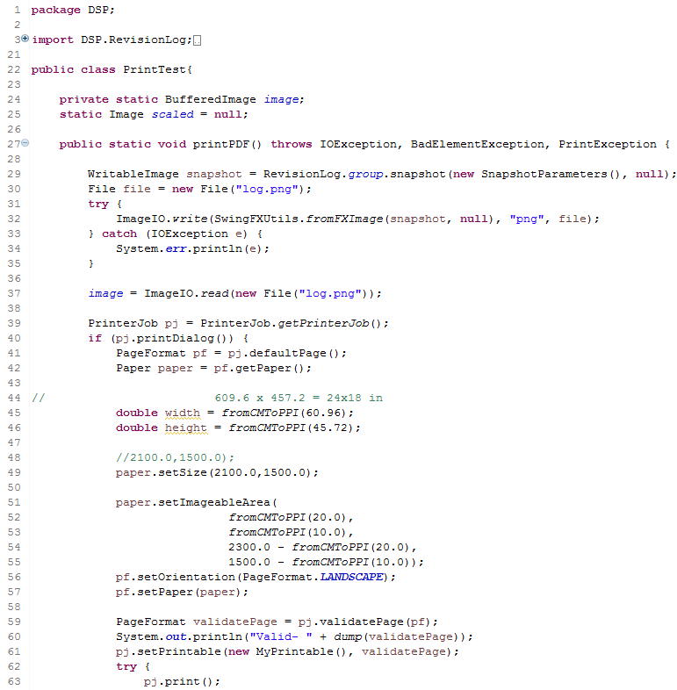
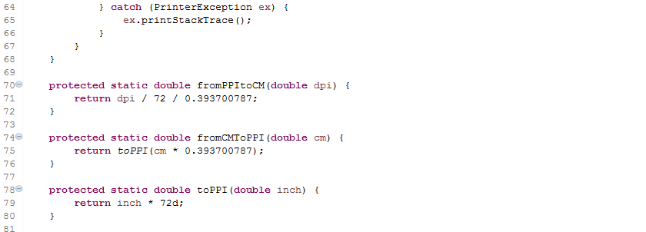
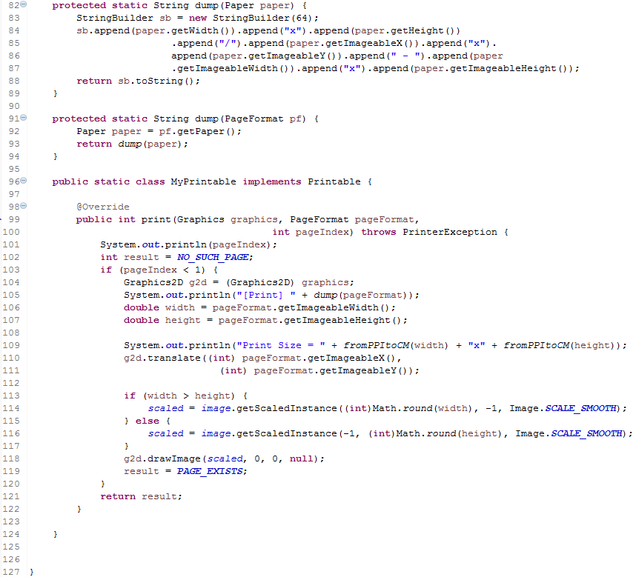
Print 2
Lines of code: Total: 126
Outside Interaction:
Is called with button functionality
Dependencies: N/A
Medium size code explanation:
The printPDF() method runs and takes the scene we are attempting to print and saves it as a png file. Then it takes the png and prints it. Before the document is sent off to the printer, the system print dialogue is brought up to select print settings prior to sending the print job through e.g. print orientation. A set of predetermined variables were defined as parameters for the print job, like the imageable width and height. Then the document is sent to the printer to print.

Slide 9
Print 3
public class Print {
/** Property names of the page format */
private static final String PROP_PAGE_ORIENTATION = "pageOrientation";// NOI18N
private static final String PROP_PAGE_WIDTH = "pageWidth";// NOI18N
private static final String PROP_PAGE_HEIGHT = "pageHeight";// NOI18N
private static final String PROP_PAGE_IMAGEABLEAREA_Y = "imageableAreaY";
private static final String PROP_PAGE_IMAGEABLEAREA_X = "imageableAreaX";
private static final String PROP_PAGE_IMAGEABLEAREA_WIDTH = "imageableAreaWidth";
private static final String PROP_PAGE_IMAGEABLEAREA_HEIGHT = "imageableAreaHeight";
static Scale scale;
/**
* Uses Java libraries to setup the printer page and to print
* @param node Is the current page to print.
*/
public static void pageSetup(Node node) { //Brings up the printing settings
Printer printer = Printer.getDefaultPrinter();
PageLayout pageLayout = printer.createPageLayout(Paper.C, PageOrientation.LANDSCAPE, Printer.MarginType.HARDWARE_MINIMUM);//Printer.MarginType.DEFAUL
PrinterJob job = PrinterJob.createPrinterJob();
if (job == null)
return;
boolean proceed = job.showPrintDialog(DSP.window);
if (proceed)
print(job, node);
//node.getTransforms().remove(scale);
} // end pageSetup
public static PageFormat getPageFormat(PrinterJob pj) {
PageFormat pageFormat = null;
pageFormat = pj.defaultPage();
Paper p = pageFormat.getPaper();
int pageOrientation = getPreferences().getInt(PROP_PAGE_ORIENTATION, pageFormat.getOrientation());
double paperWidth = getPreferences().getDouble(PROP_PAGE_WIDTH, p.getWidth());
double paperHeight = getPreferences().getDouble(PROP_PAGE_HEIGHT, p.getHeight());
double iaWidth = getPreferences().getDouble(PROP_PAGE_IMAGEABLEAREA_WIDTH, p.getImageableWidth());
double iaHeight = getPreferences().getDouble(PROP_PAGE_IMAGEABLEAREA_HEIGHT, p.getImageableHeight());
double iaX = getPreferences().getDouble(PROP_PAGE_IMAGEABLEAREA_X, p.getImageableX());
double iaY = getPreferences().getDouble(PROP_PAGE_IMAGEABLEAREA_Y, p.getImageableY());
pageFormat.setOrientation(pageOrientation);
p.setSize(paperWidth, paperHeight);
p.setImageableArea(iaX, iaY, iaWidth, iaHeight);
pageFormat.setPaper(p);
return pageFormat;
}
private static void print(PrinterJob job, Node node) { //Prints the page
boolean printed = job.printPage(node);
if (printed)
job.endJob(); //End the printer job
else { //Printing Error
Alert printerError = new Alert(AlertType.ERROR);
printerError.setTitle("Error");
printerError.setHeaderText("Printing Error");
printerError.setContentText("Uh oh! That's not supposed to happen!");
printerError.initModality(Modality.APPLICATION_MODAL);
printerError.showAndWait();
}
}// end print
}
Lines of code: Total: 67
Outside Interaction:
Is called with button functionality and sent through with a node
Dependencies: That a node is sent as a parameter
Medium size code explanation:
The pageSetup() method runs and takes the scene we are attempting to print as a node. Before the document is sent off to the printer, the system print dialogue is brought up to select print settings prior to sending the print job through e.g. print orientation. A set of predetermined variables were defined as parameters for the print job, like the imageable width and height. Then the document is sent to the printer to print.

